Slide 1
Herts Welcomes Syrian Families AGM 9th April 2019

Slide 2
Second year as a Charity 1162798
Key themes of Welcome, Support and Help with Integration continue
Notes:
Some changes to our trustees. Gary Sutcliffe has resigned and we are looking for the AGM to elect John Borton.

Slide 3
Local Convenor network strengthened
Notes:
There are now nearly 50 families so this we can’t do county events. Things happening more locally but we do combine if we can. Not all the local convernors are trustees

Slide 4
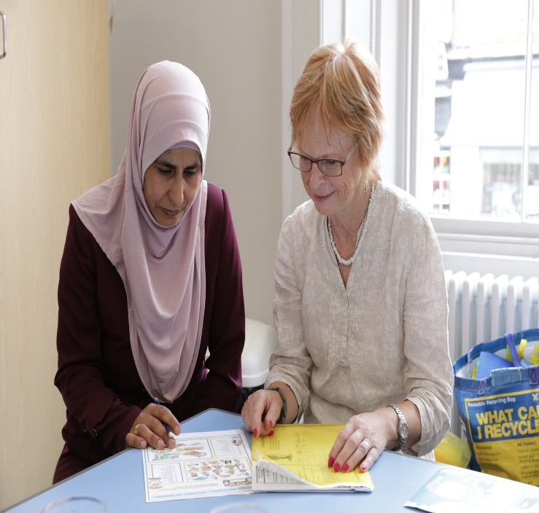
ESOL (English for Speakers of Other Languages) Volunteer Coordinator Appointed
Caroline Herring appointed in February
to develop our Language Support volunteer
Network - recruiting and matching volunteers
with individuals in the home to help them
practise their English.
We also thank the volunteers who work in a
variety of other ways, general befriending, driving, gardening and setting up informal conversation groups.
Notes:
We now have sufficient funding for Caroline to continue to the end of 2109. She will now have 18 hours a week instead of 9. This is because we were successful with CDA Community Action Development to secure funding for a project for women which will run until the end of the year and also a donation from COSARAF.
We have now in the region of 70 volunteers working in a variety of ways across the county. Transport still a problem and we really need a volunteer to help us with thee record keeping, recording and checking for volunteer drivers. At the moment local convenors are doing this but we need more help with this scheme. Are you that person? Can be done from home, you just need good admin skills.

Slide 5
Welcome activities continue
Notes:
These have changed slightly - before we offered a meal on the first day of arrival. Now we provide a food hamper and join the RC or council in their welcome event.

Slide 6
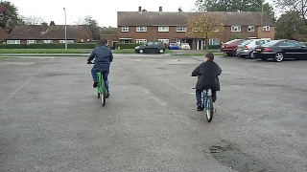
Support for Families Cycles Scheme
Notes:
The cycle scheme continues to be a great success. In 2018 63 bikes 5 scooters delivered across the county. All are provided with a safety package, locks helmets and visors. We are having to buy more expensive locks as are finding that bikes are getting stolen.

Slide 7
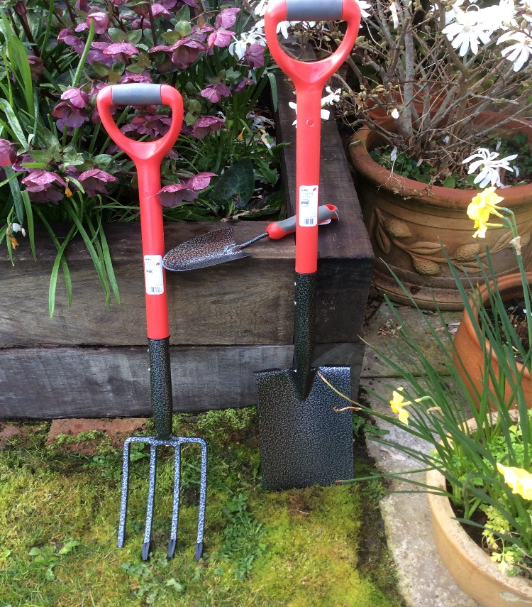
Support for families
Notes:
As part of the wecome package we still provide a TV and pay for a licence for a year.
WE have talked about the bike scheme but also additional goods that might be needed. Gardening equipment and lawnmowers are one. Sofa’s household equipment and help with transport and fares. We have for example paid for taxi fares for someone to get to a hospital appointment where there are no public transport links. Also starting to help with driving lessons if funds can’t be secured elsewhere. Also helping others not part of the scheme.
We have started to advertise on our Facebook page for goods and this is proving quite successful.

Slide 8
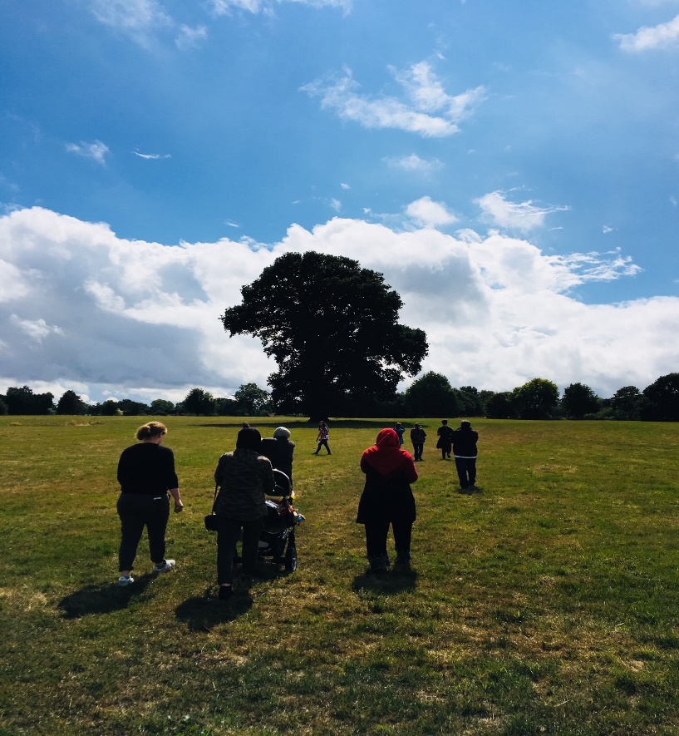
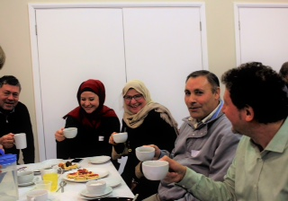
A variety of activities and events organised in areas
Notes:
Activities. Shared meals, parties . Walking group in Dacorum
Shared tea at the Masourti Synaguge - for which we were nominated in the Herts Advertisor award under the Good Neighbour Category.

Slide 9
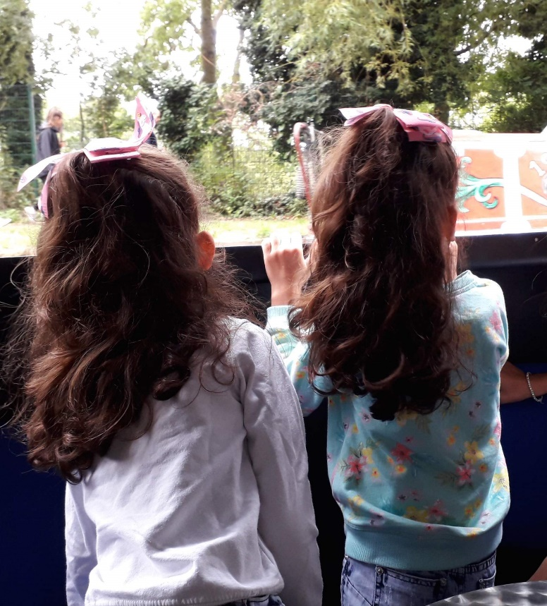
Summer activities
Notes:
Barge trip in Ware, visits to museums.

Slide 10
Gifts to families continue – Summer and Christmas

Slide 11
Enabling them to support each other
Notes:
Thankful to Enas again for her Christmas card designs which raised about £800 this year for our charity Cooking for each other.

Slide 12
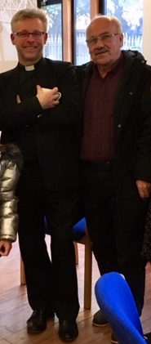
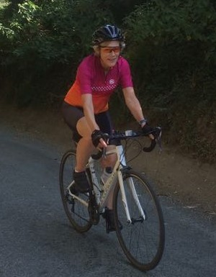
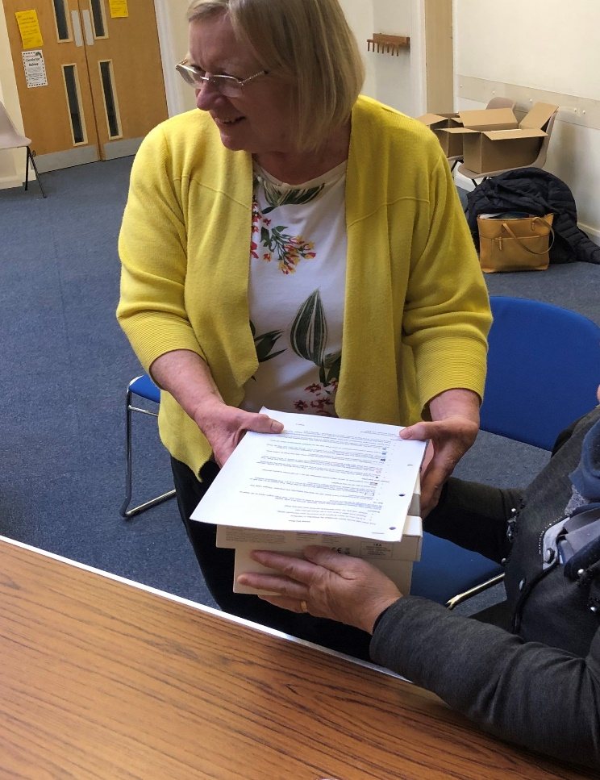
A thank you to to those who have helped raise funds and provide goods for us
Notes:
Thankful to those who have fundraised for us. Rev David Munchin deserves a special mention = he rode his bike to Rome and raised over £5000.
Our Volunteer coordinator with her bike ride.
Cake sales in the East of the County
Also to a volunteer who organised kindles for some in the East of the County.
ICT is important and we are exploring how we can ensure that each family, particularly those with school age children have got the right equipment. We are careful about second hand equipment as often it breaks down and can’t run the programmes needed. So won’t accept any computers which do not have Windows 10.
With 50 families, this will involve more fundraising and training.

Slide 13
Priorities for next year
To continue to support the families and other refugees and respond to changing needs.
To continue to run events that support wellbeing and integration.
To continue with our Language Support/ befriender network and bid for further funds to maintain this.
To set up and pilot women's groups in different parts of the county.
To explore how we might support refugees not coming through the Government scheme.
To strengthen and help with access to employment.
To consult with the families on how they could be more involved with our organisation.
To strengthen our Volunteer Driver network across the county.
To continue to fundraise and encourage other organisations to help us with this.
Notes:
Things are certainly changing from when we first started. WE would never have imagined we would have our own volunteer network as we have.
Also challenges for the families are changing. You will here more about these later. From the families themselves.

Slide 14
None of this could have been done without your help and support so once again thank you
Notes:
Thank you to all our volunteers who give some much of the time unpaid to the charity.
Thank you also to those organisations and individuals who support ius in a number of ways offering their premises, organising events with us, partnering with us.
We do not work in isolation.

